Slide 1
Inventory management System
Name | Student ID | Section
Ibrahim ayman alqurshi | 2046430 | ZR
Moath mosleh alsolami | 1935160
Omer saeed al-zahrani | 2046430
Fahad Hamad alsifri | 1743998
Abdullah justaniah | 2037017

Slide 2
About
This Database project is about Managing Inventory for a particular Retail Store and Cover all the aspects of warehouses and it is information , as well it’s keep track and manages Customers and their Orders and Products ,Payments , and Stores records and all necessary information for the management department ,who they budgeting the warehouse , in addition Mangers will manage Other Employees and warehouses
keeping track of stock, income, and expense.
manages and tracks Products, Customers. Payments.
Saves Orders for future reference.
Product Suppliers information.
information for Management Department..

Slide 3
Entities
Employee ( empID , Name(Fname,Mname,Lname) , SSN , Phone , Address, Salary)
Dependent ( Phone , Name(Fname,Mname,Lname))
Warehouse (WhID , Capacity)
Management Department ( ID , Expense , Income);
Product ( PID , Pname , Price)
Supplier(SID , Sname, Address , Phone)
Order( OrderID , Date , TotalPrice )
Customer (Phone , Name(Fname,Mname,Lname) , Address)
Payment(PaymentID , Receipt , Date , PaymentType)

Slide 4
Relationships
- Relationship between Employee and Dependent:
Each employee can have multiple dependent .
Each dependent Must have one employee.
- Relationship between employee and employee:
employee must have one supervisor.
employee can be supervisor.
- Relationship between warehouse and employee:
Each employee Must work for one warehouse.
One employee can be a manager for one warehouse.
Each warehouse must have one manager.
- Relationship between warehouse and product:
Each warehouse can have multiple products.
Each warehouse must have at least one product.
-Relationship between warehouse and management Department:
only one management department can have multiple warehouse.
Every warehouse must have only one management department.
Relationship between Supplier and product:
Each product must have at least one supplier.
Each supplier can have multiple products.

Slide 5
Relationships
- Relationship between product and order:
Every product can be put in multiple orders.
Every order can have multiple products.
- Relationship between customer and order:
Each customer can have multiple orders
Each order must have one customer.
- Relationship between payment and customer:
Each customer can make multiple payment

Slide 6
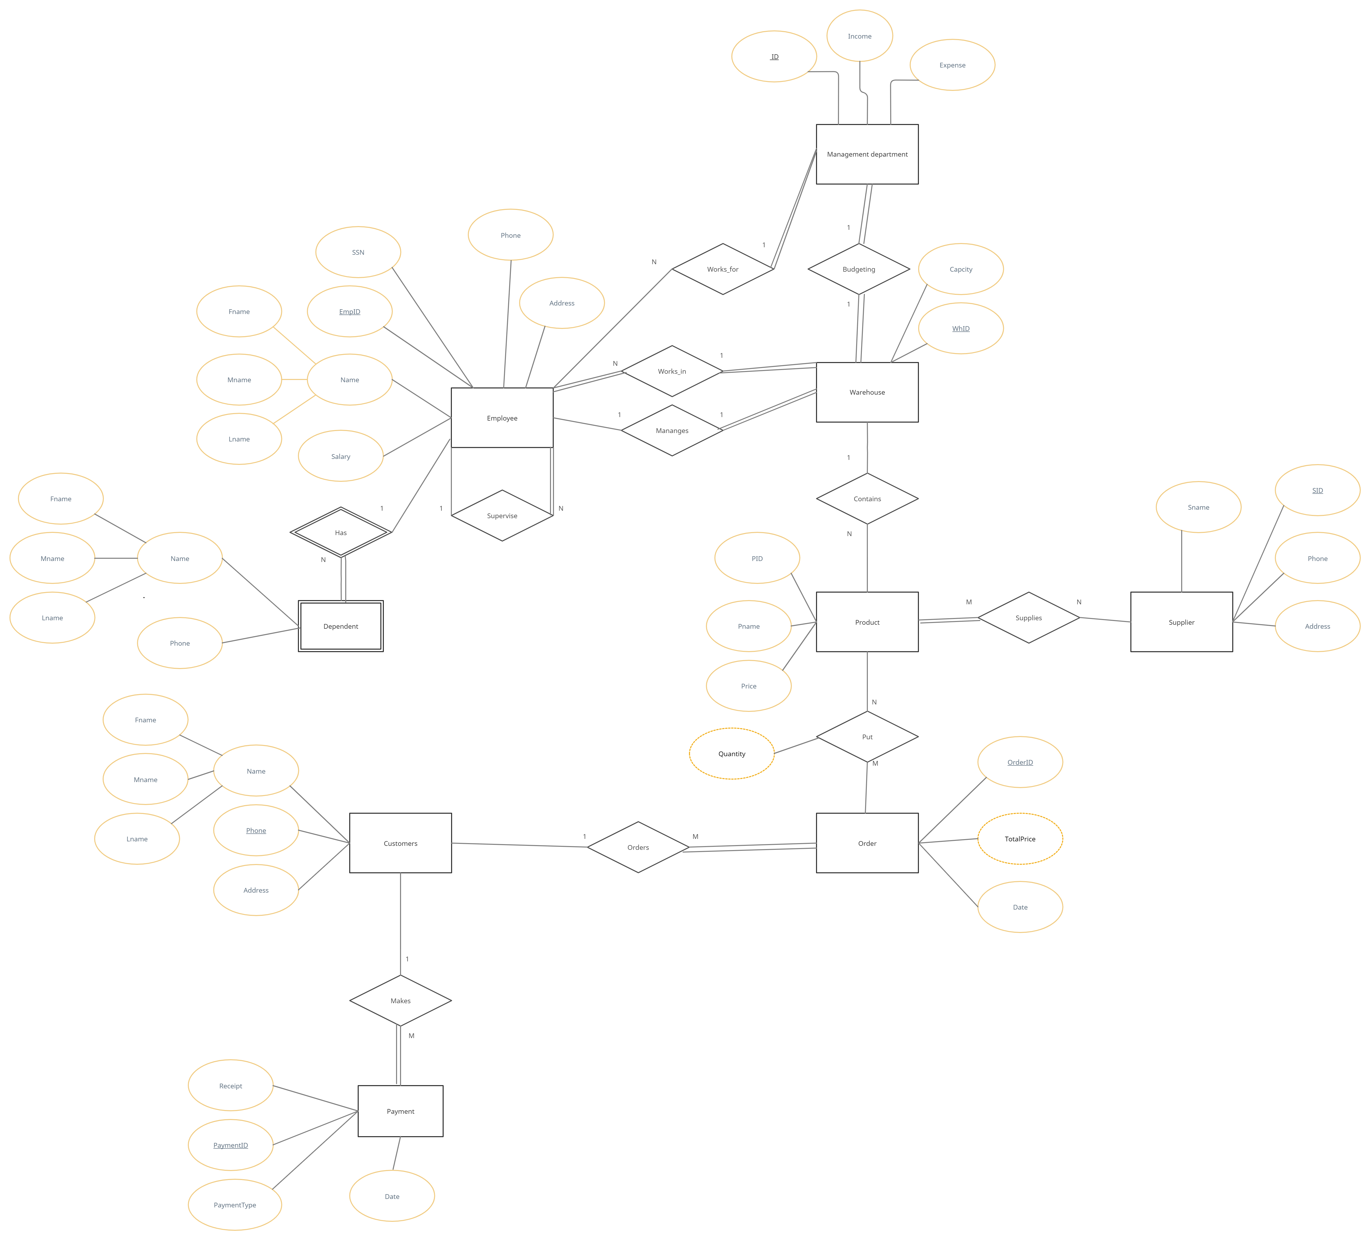
ER diagram

Slide 7
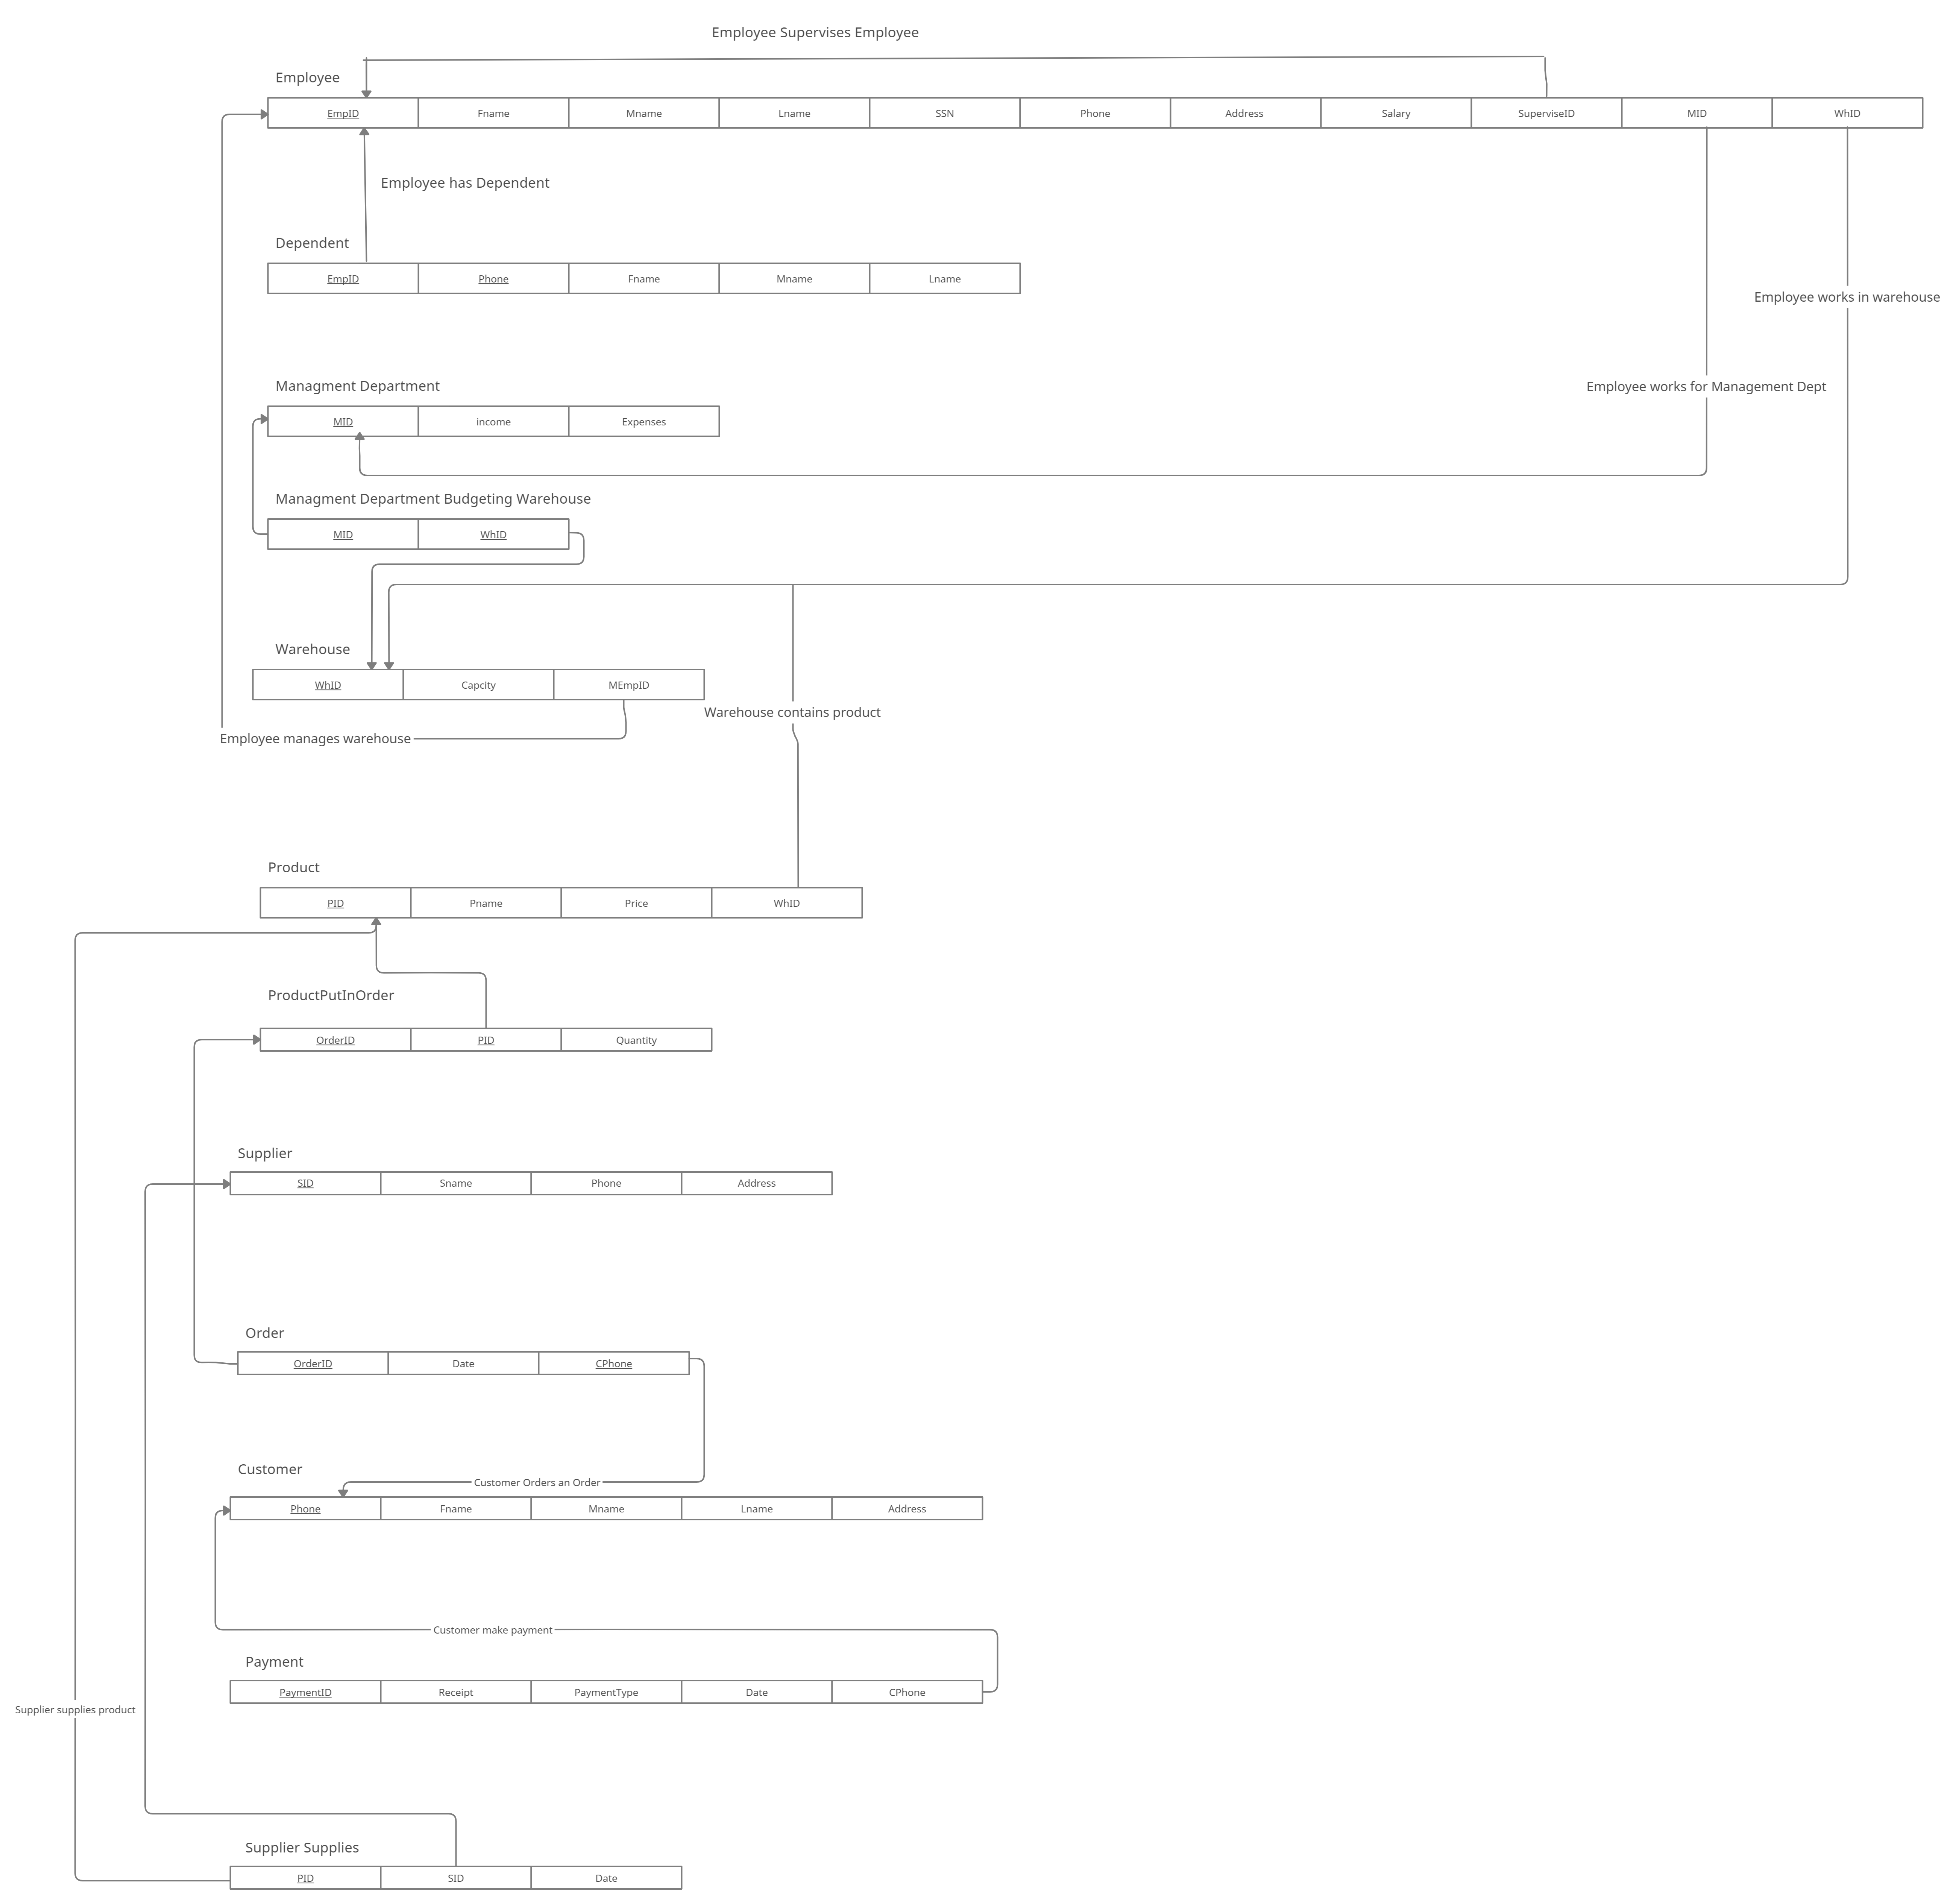
Schema diagram

